Slide 1
Team PlacHolder
Business Application Programming Project

Slide 2
General overview
We are making a holiday letting website for our Haukainga HomeWinds project, centred on locations in New Zealand. The goal has been to create a website reminiscent of website in the same market as websites such as Bachcare, AirB&B, or Booking.
With this service for our customers, it provides both a great service to people from New Zealand and to visiting tourists, showing off fantastic Māori locale.

Slide 3
Constraints and boundaries
As this project is part of an academic assignment, we will have to consider that long-term support of this website may not be initially made, but could be made on a future date, after completion. Because of this, we will be further constrained to website options that do not require payment, will not cost additional fees, and will not involve e-commerce functionality, including domain name costs, website hosting costs, and the ability for users to make purchases.

Slide 4
Business and value-add
The value-add of this website will be from the cost of production, implementation, and possible maintenance of the website itself, as this product is being done as an academic assignment. Furthermore, because of this, costs for designers and developers of the website will not be needed, saving over $10,000. The fully-functional website itself will also contribute to the value-add for the client, showcasing additional (outside-scope) functionality to stakeholders or other developers.

Slide 5
Development of the Plugin

Slide 6
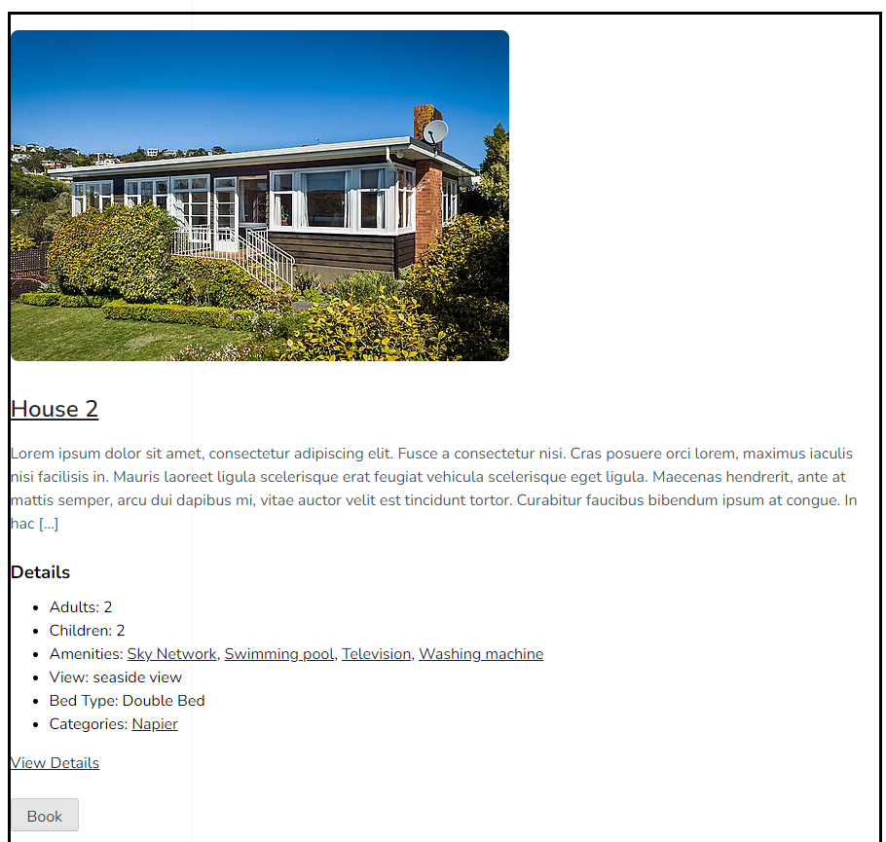
How the Properties will be displayed

Slide 7
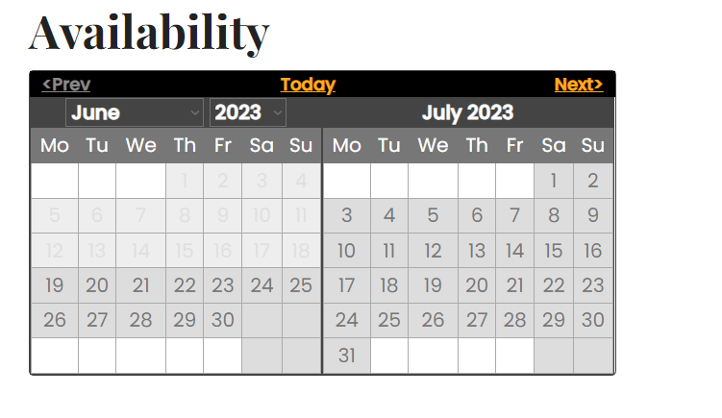
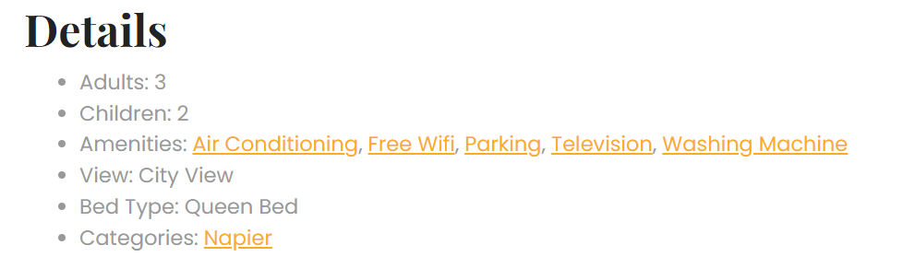
What is contained in a property page

Slide 8
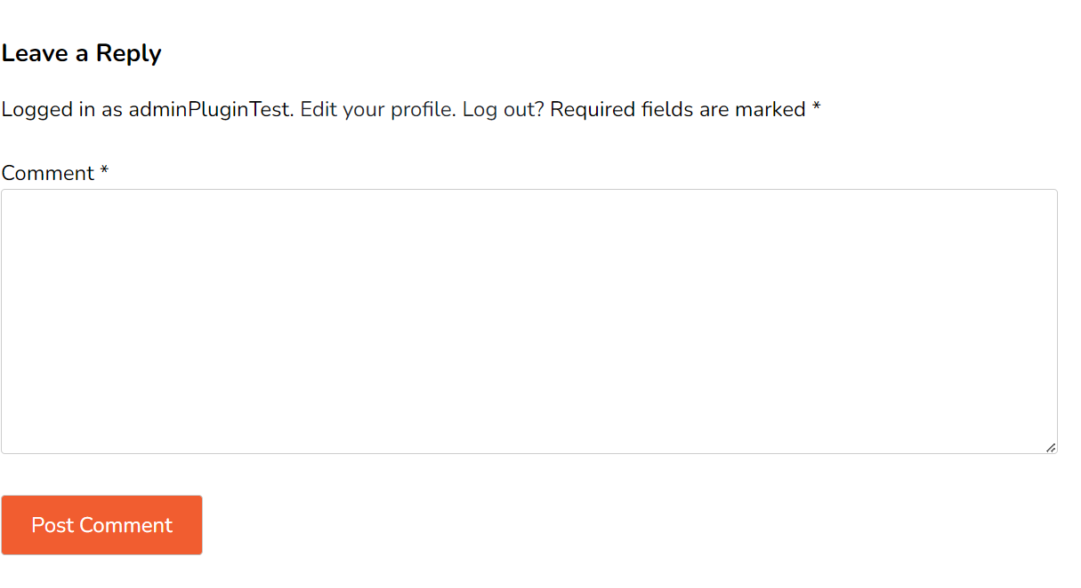
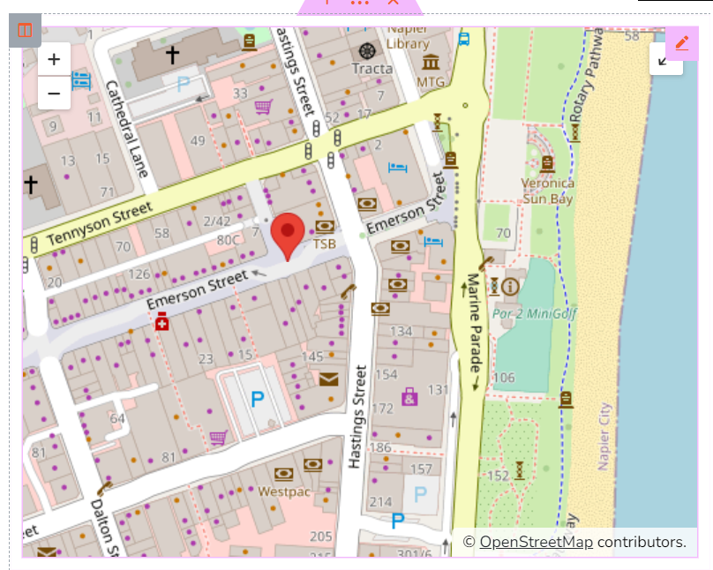
What is contained in a property page part 2

Slide 9
Highlights of Development
The functionality provided by Hotel Booking Lite
Creating a Community for an E-commerce site

Slide 10
Thank you for listening

